Slide 1
British Female Competition Skydiving Team
Opportunity & PROPOSAL

Slide 2
Who we are
The British Female Competition Skydiving Team
NFTO = Not For The Ordinary
Current British National Female Outdoor and Indoor Skydive Team
Gold Medalists Indoor Skydiving World Cup 2018
Having won Silver at the 2018 World Parachuting Championships and 2019 World Cup, the team aim is Gold at the 2022 World Parachuting Championships
NFTO – Not For The Ordinary
Four women doing extraordinary things

Slide 3
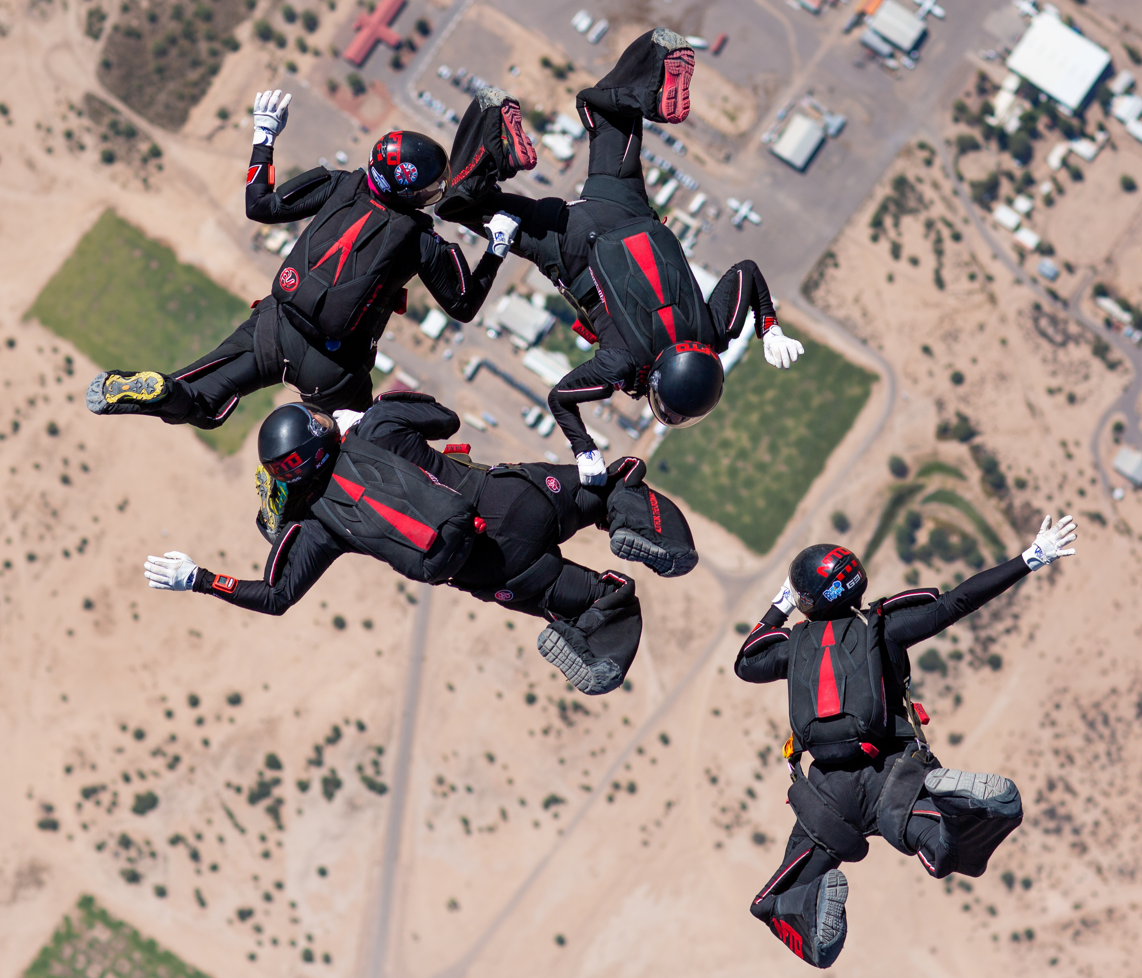
An Opportunity To Make A Difference
Skydiving is one of the most exciting and fastest-growing sports in the world. Media interest and exposure continues to increase with videos from recent competitions gaining over 33 million views online.
NFTO is a team of four determined, self-reliant women with a strong military link in a world where women’s sport is beginning to be appreciated as exciting and skillful, and growing at pace.
Female physical activity levels globally are critically low, and this has major health, social and economic implications. Due to high-profile public and government concerns, there is an ideal opportunity to invest in addressing these issues and, in doing so, demonstrate and be recognised for their wider contribution to society.

Slide 4
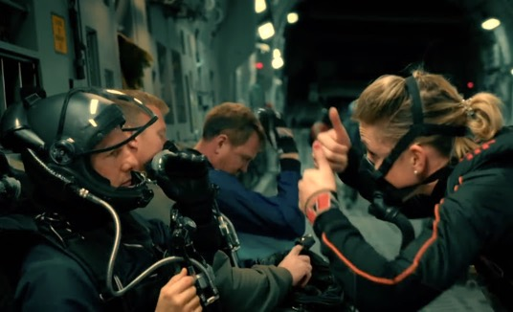
How We Add Value - Our Aims and Brand
We are always ready for a challenge, and we aspire to be the best.
We are the British team, aiming for Gold at the 2022 World Parachuting Championships in the USA and Gold at the Indoor Skydiving World Championships 2023 in Norway. We will also defend our British Outdoor Open Championships in 2022.
Two of the team recently worked on Mission: Impossible - Fallout as part of the HALO (high altitude, low opening) skydive stunt team, working daily with Tom Cruise in the roles of safety diver, coach, and HALO aviation medicine doctor.
We have appeared on the BBC’s The One Show, James May's Toy Stories, Blue Peter, BBC news, and in an Epic TV documentary. Our television adverts include Seven Seas Multibionita.
We have strong followings and are active on social media channels including Facebook, Instagram, and Twitter.
Anna & Siân working with Tom Cruise on Mission: Impossible - Fallout
The team and Jimmy Carr on BBC The One Show

Slide 5
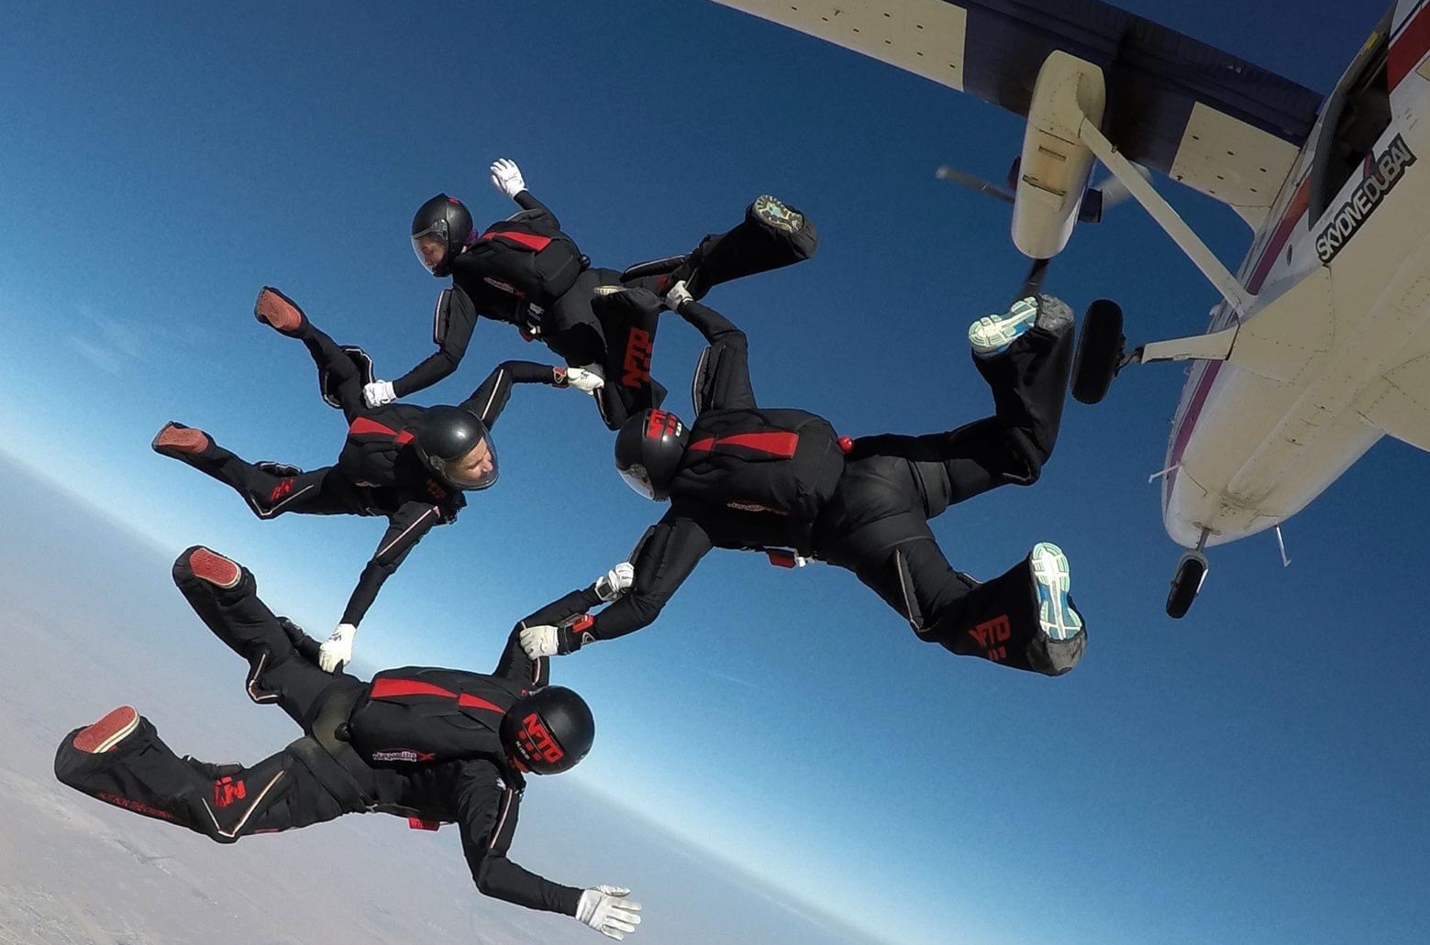
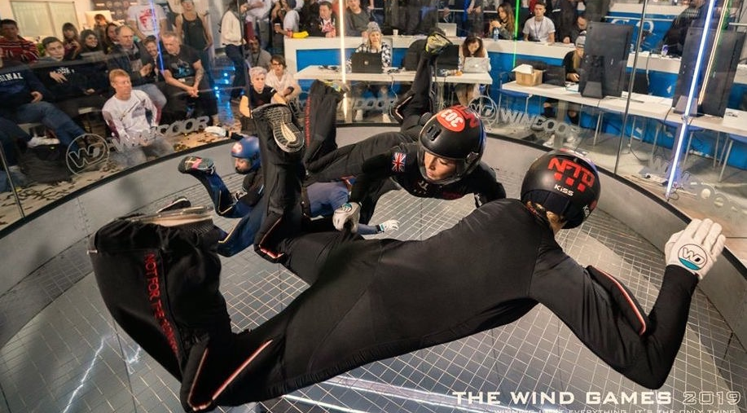
What is Competition Skydiving?
Competitive 4-way formation skydiving is a fast and furious discipline
There are approximately 50 formations used in skydiving competitions
A team is four skydivers plus an aerial camera person
Each competition has 10 rounds
The day before a competition 10 sets of formations are drawn at random to make up the sequences required for the 10 different rounds
Each team must perform the exact sequence as prescribed for each round as many times as possible
Each team has 35 seconds starting the moment they leave the aircraft to complete each round’s pre-determined sequence of formations as many times as possible
Judges on the ground use the aerial footage to determine if sequences have been performed correctly and award points accordingly
Indoor Skydiving
Indoor skydiving is the simulation of true freefall skydiving conditions in a vertical wind tunnel, where huge fans create up to 180 mph wind. It is where the dream of flight becomes a reality
Indoor skydiving is an international competitive sport in it’s own right.
What is Indoor Skydiving?

Slide 6
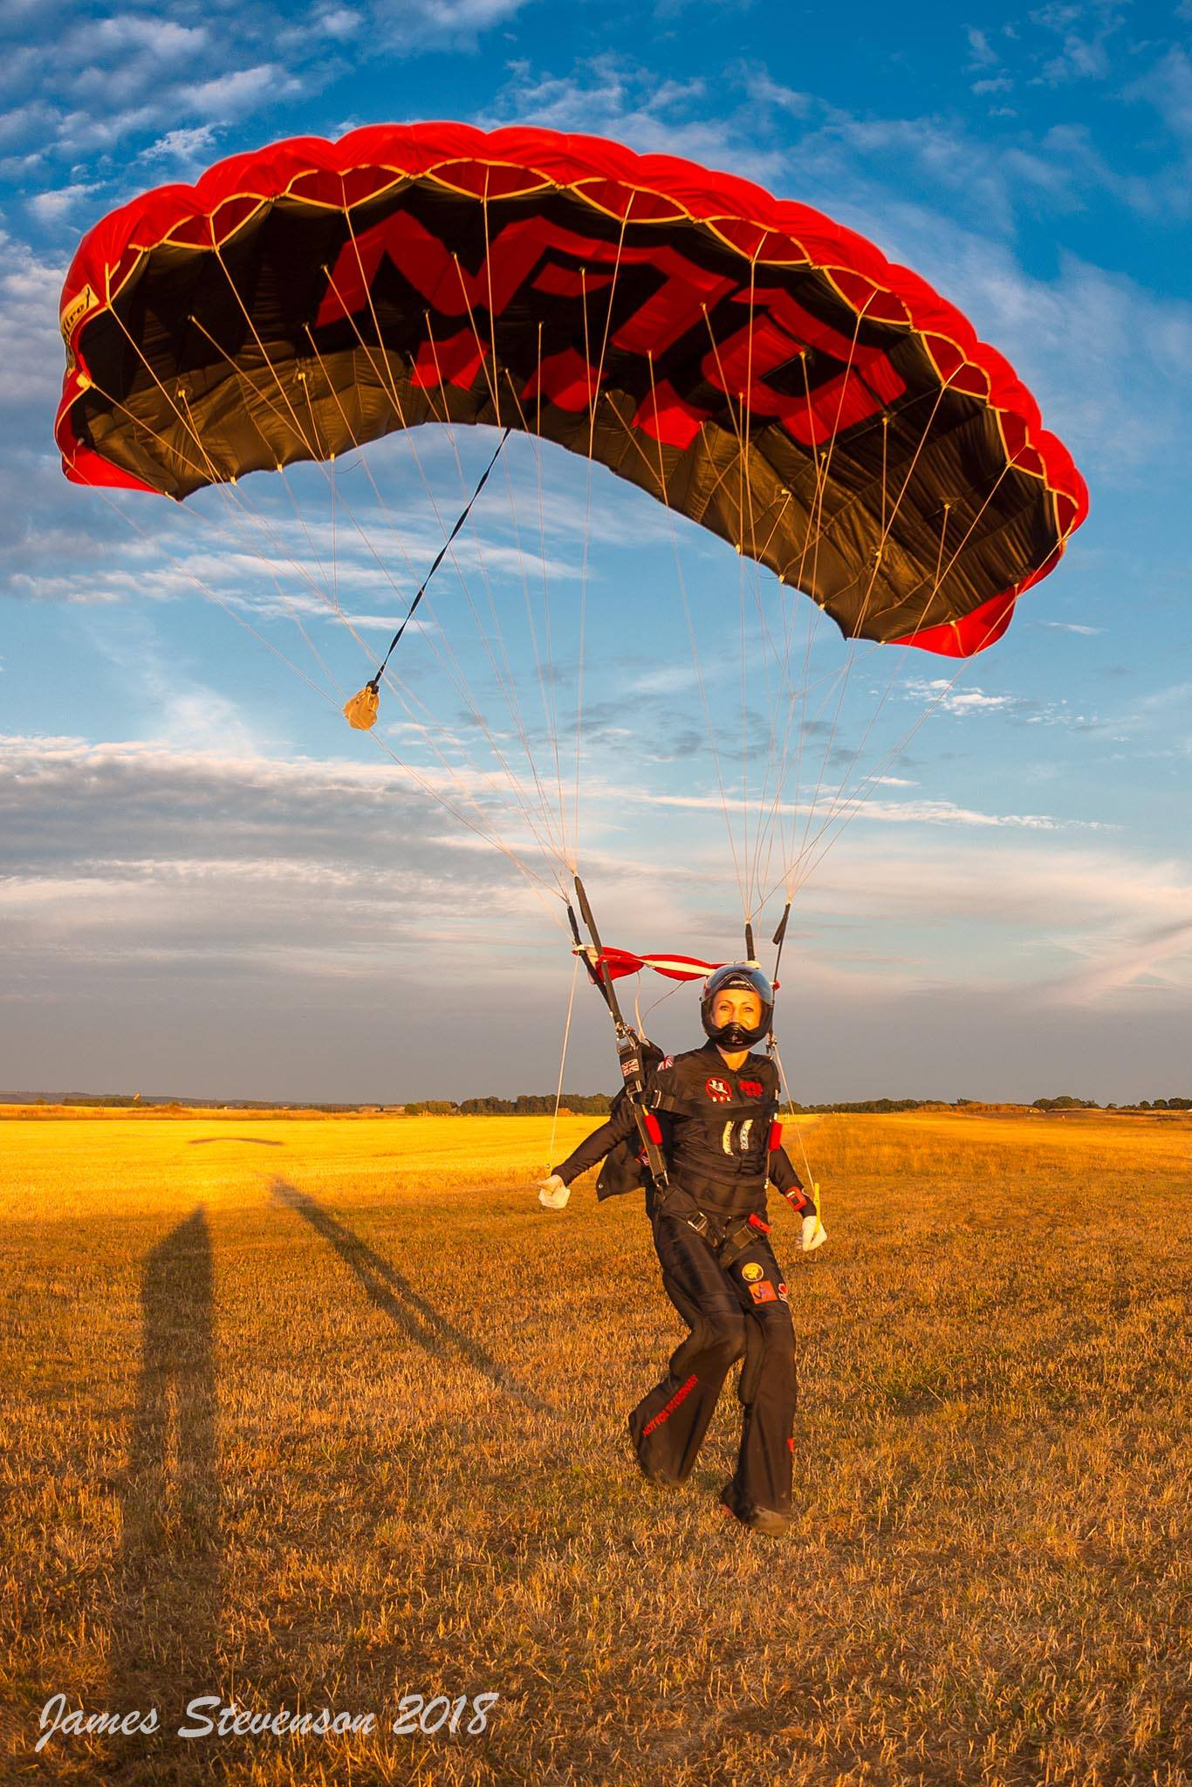
What NFTO Can Offer You
Indoor and Outdoor skydiving is experiencing rapid growth in participation as well as attracting increasing attention from media and spectators alike. Extreme sports in general are gaining momentum and positive female role models are making waves.
Our camera flyer is one of the best in the sport and can supply stunning aerial footage and photography
With our feminine yet strong image, as a team of independent and dedicated women we can be used for many inspirational promotions
We are a particularly marketable and media-savvy team
All our kit from clothing to equipment offers amazing branding opportunities
We already have media interest that we can leverage
We are available for motivational talks, skydive display jumps, wind tunnel days and other events

Slide 7
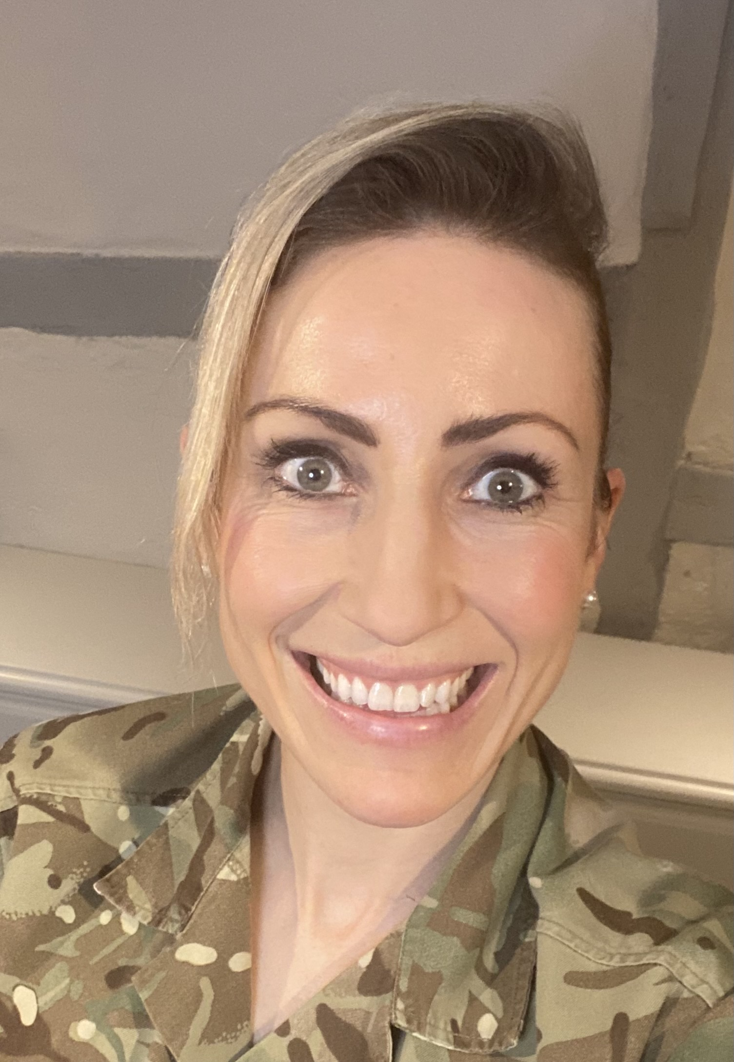
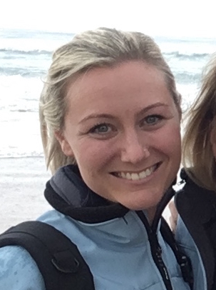
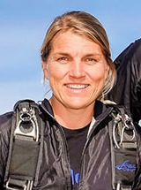
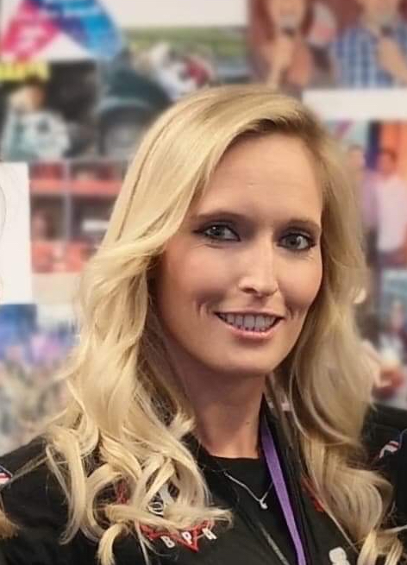
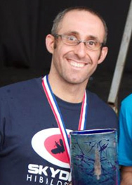
Meet the team
Between us we have an array of gold, silver, and bronze medals at national and international competition level, many thousands of jumps, and many hundreds of hours of flying indoors. We are personally financially invested in our own team and passionately believe we have the optimum conditions to win World Gold in 2022.
Anna Hicks
Cath Curtis
Vana Parker
Siân Stokes
Simon Brentford
Army Doctor, Accelerated Freefall Instructor
NHS Dietician
Sports Massage Therapist
Full Time Skydiving Instructor
Camera Flyer and Web Designer

Slide 8
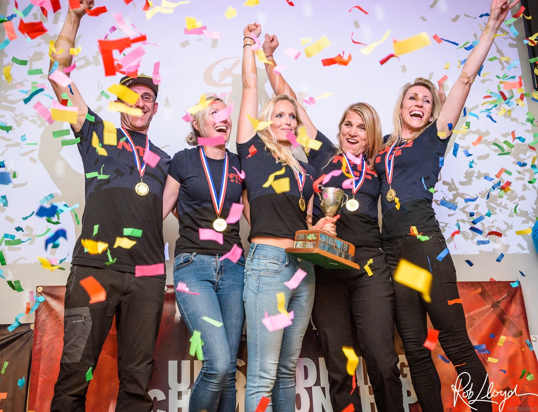
Opportunity
Thank you very much for your time and interest in us as the British national team
We would love the opportunity to discuss any funding opportunities and how we could both benefit from a strategic partnership.
NFTO Socials And Contact Details
Website: NFTOskydiving.co.uk
Instagram: nfto_skydiving_team
Facebook: NFTOSkydivingTeam
Twitter: NFTOSkydiving
Email: annajlea@hotmail.com
Phone: +44 7775 628 691

